Slide 1

Text Analytics: Cybercrime Detection in Pakistan
Dr. Khurram Shahzad, Hammad Akram
Department of Data Science,
University of the Punjab, Lahore
Techlogix, Inc. Lahore

Slide 2
Agenda
Introduction
Text processing
Cybercrime act of Pakistan
Text Analytics
Implementation

Slide 3
Introduction
Natural Language Processing (NLP) is a subfield of linguistics, computer science and artificial intelligence
“It concerns about how to program computers to understand & process natural language text”

Slide 4
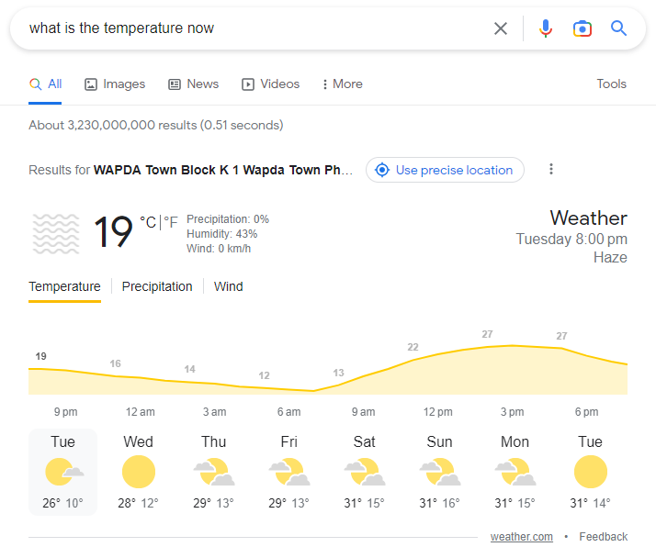
NLP Applications: Question answering

Slide 5
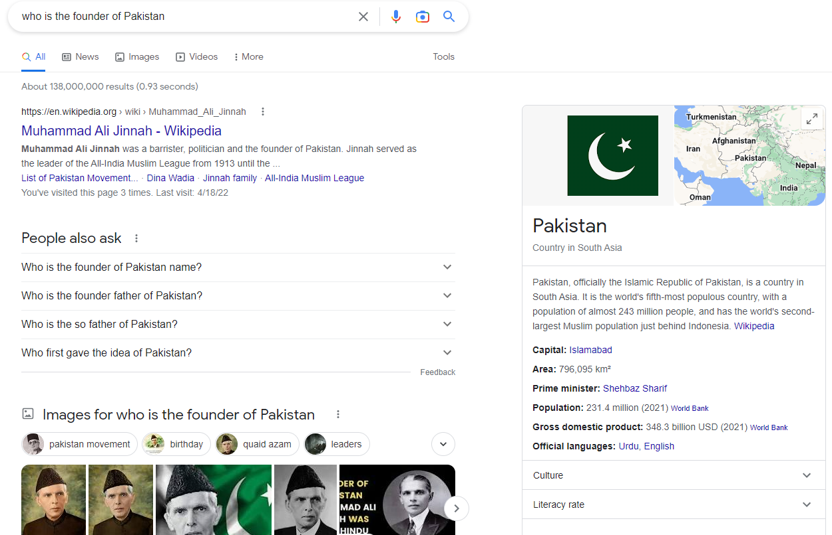
NLP Applications: Question answering

Slide 6
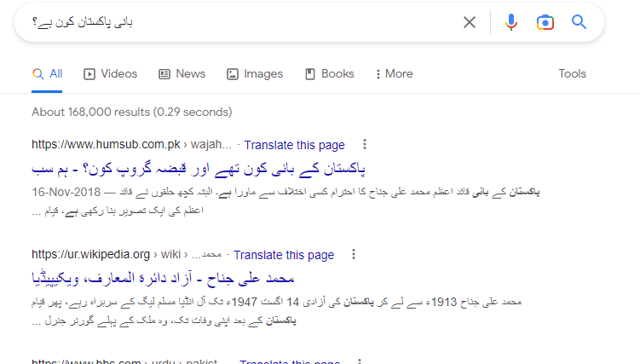
NLP Applications: Question answering

Slide 7
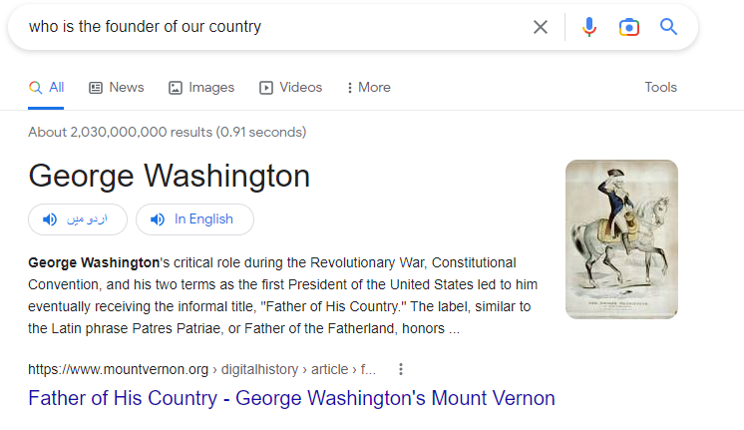
Problem: Question answering

Slide 8
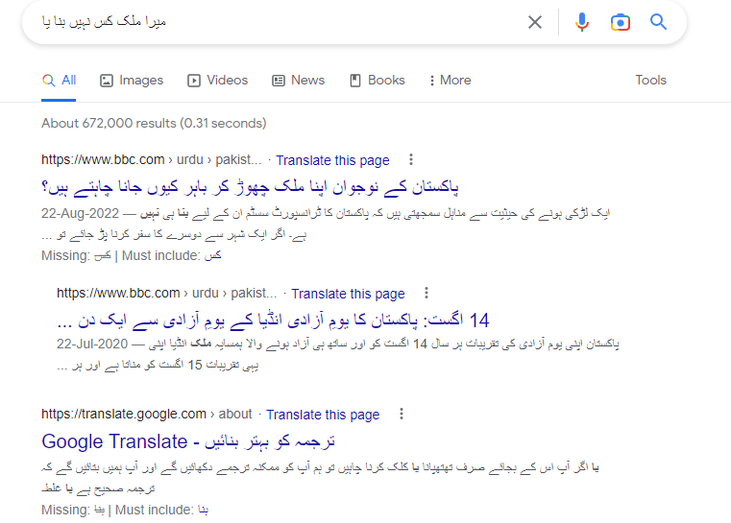
Problem: Question answering

Slide 9

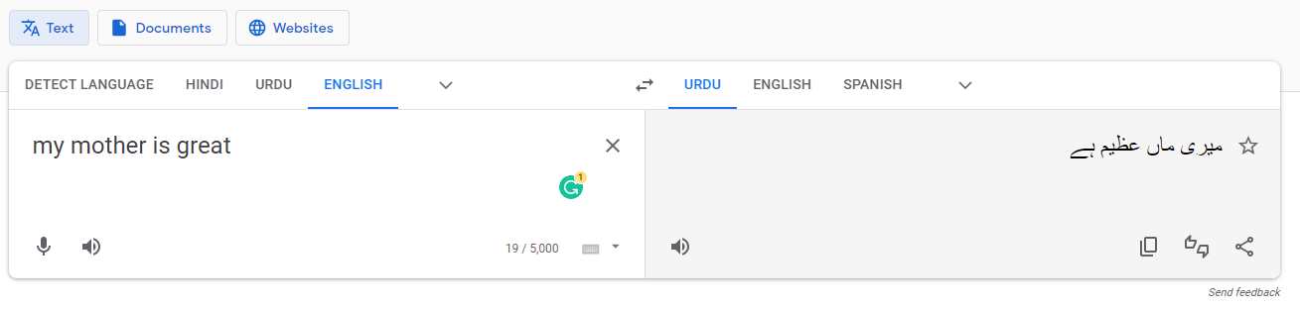
NLP Applications: Machine translation

Slide 10
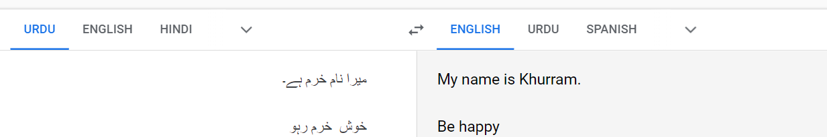
NLP Applications: Machine translation

Slide 11
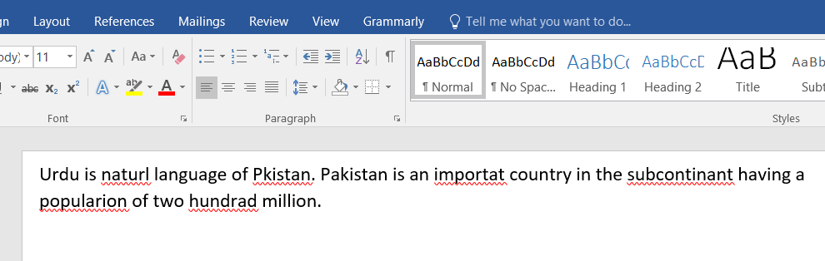
NLP Applications: Spell checker

Slide 12
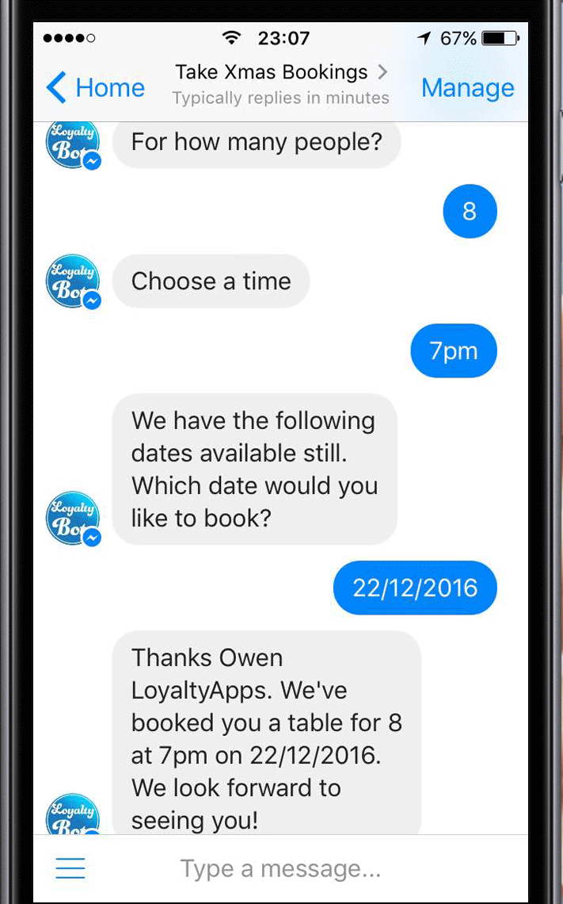
NLP Applications: Chatbot

Slide 13
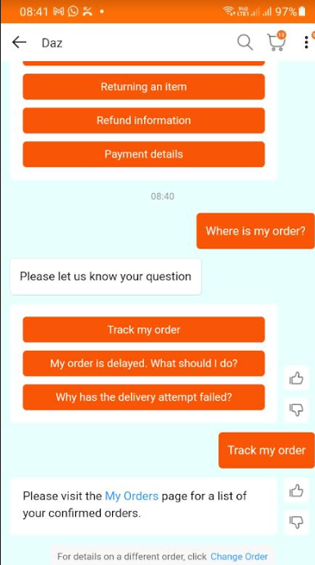
NLP Applications: Chatbot

Slide 14
All this is achieved by ….

Slide 15


Slide 16
Artificial Intelligence
The development of computer systems that is able to perform tasks normally requiring human intelligence…

Slide 17
Guess the next number
1, 2, 3, …

Slide 18
Guess the next number
2, 4, 6, …

Slide 19
Guess the next number
2 * 1 = 2
2* 2 = 4
2* 3 = 6
2* 4 = 8
2* 5 = 10
…
2* 31 = ?

Slide 20
Guess the next number
24565235421
+
12324642328

Slide 21
Guess the next number
24565235421+
12324642328 =
36889787749

Slide 22
Guess the next number
1, 2, 3, …
2, 4, 6, …
2, 4, 6, 8, 10, … 62
- Why could you guess it?
Notes:
Two reasons for the correct guesses
You have learned to count
You have learned to find the pattern

Slide 23
Guess the next number
8, 10, 14, 28, 36, 42, 56, 66…

Slide 24
Guess the next number
8, 10, 14, 28, 36, 42, 56, 66…
- Why you could not guess it?
No pattern…

Slide 25
Guess the next number
8, …

Slide 26
Guess the next number
8, …
- Why you could not guess it?
Not enough data…
Notes:
Reasons for incorrect guesses
Although you have been taught to count, but you were unable to learn the pattern
You do not have adequate data to learn the pattern

Slide 27
Two reasons
No pattern
Inadequate Data

Slide 28
Therefore, AI equation
AI System = Code + Data
(model/algorithm/method)

Slide 29
Artificial Intelligence
The development of computer systems that is able to perform tasks normally requiring human intelligence…

Slide 30
Cybercrime Act of Pakistan
Before applying text analytics, understand what is Cybercrime Act of Pakistan
Official Name: Prevention of Electronic Crimes Act (PECA)
Passed in year 2016

Slide 31
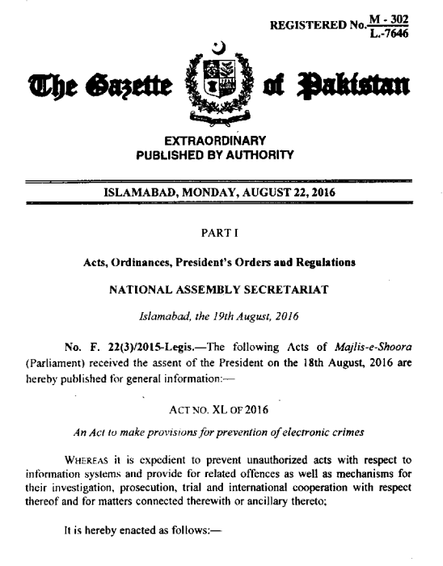

Slide 32
Cybercrime Act of Pakistan
“Whoever commits or threatens to commit any other offenses … with the intent to-”
“advance interfaith, sectarian or ethnic hatred”

Slide 33
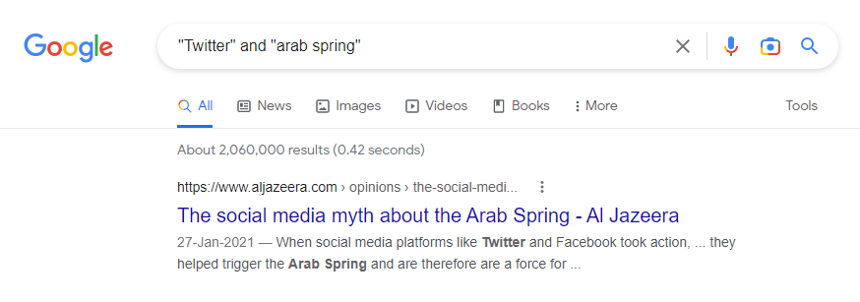
Cybercrime Act of Pakistan
Twitter has more than 300 million active users
Social media has greater impact on society

Slide 34
The AI equation
AI System = Code + Data
(model/algorithm/method)

Slide 35
Data scrapping
How to prepare training data?
Scrapped ~100,000 tweets
What should be scrapped?

Slide 36
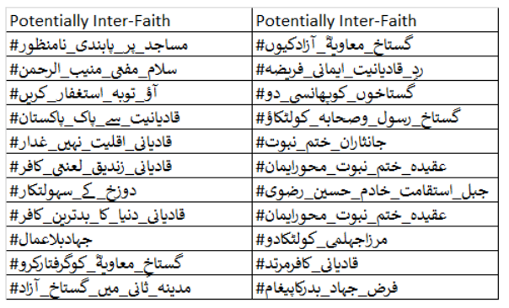
Data scrapping keywords

Slide 37
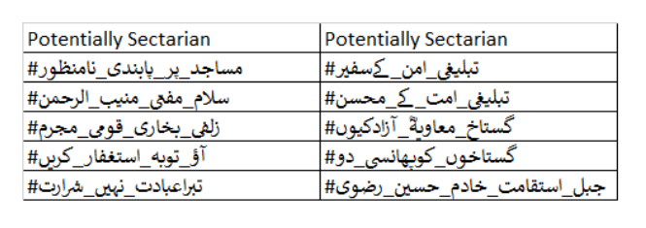
Data scrapping keywords

Slide 38
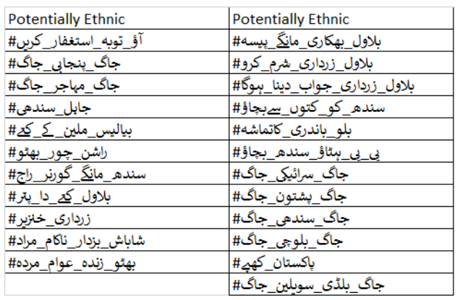
Data scrapping keywords

Slide 39
Data scrapping keywords

Slide 40
Data scrapping keywords

Slide 41
Publication
Hammad Akram, Khurram Shahzad, Maryam Bashir. ISE-Hate: A Benchmark Corpus for Inter-faith, Sectarian, and Ethnic Hatred Detection on Social Media in Urdu. Information Processing & Management, 60(3), pp. 103270-103293, 2023.

Slide 42
Dataset for download
https://github.com/hammad7007/ISE_dataset

Slide 43

University of the Punjab
email at khurram@pucit.edu.pk

